Slide 1

Devnet Certification Study Group
A League of Extraordinary Engineers

Slide 2

Purpose
Create a cohort of interested engineers to blaze the trail to certification success
Leverage herd mentality
Drive engagement, encourage accountability
Foster team growth

Slide 3
Structure
Pacific (PST/PDT) / AZ Summer (MST) | Mountain (MST/MDT) / AZ Winter (MST) | Central | Eastern
10:00 AM | 11:00 AM | 12:00 PM | 1:00 PM
Weekly, 11am MST (GMT-7)
Note timezone changes
Alternating presenters for review,
1) Visbility, cross functional give back
2) immersion, you will retain that subject best when forced to retell the message

Slide 4
Mythbusters
Cisco wants us to be developers
DevASC is programming intense.
DevASC is not relevant to SE’s

Slide 5
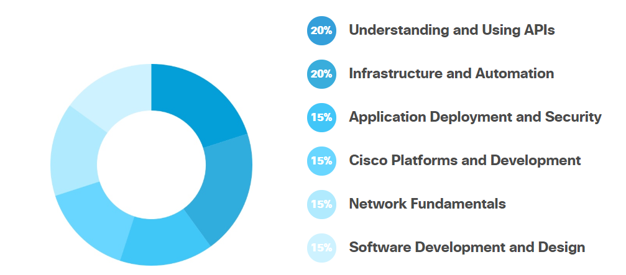
Knowledge domains
https://developer.cisco.com/certification/devnet-associate/

Slide 6
Syllabus/Logistics
Date | Topic
7/31 | Kickoff – Dev environment, Github
8/7 | Module 1 – 1.1-1.8
8/14 | Module 2 : 2.1-2.9
8/21 | Module 3.1 – 3.5
8/28 | Mod 3.6+
9/4 | Mod 4.1-4.5
9/11 | 5.X
9/18 | 5.X.2
Tools:
Teams room
Digital learning
Quizlet
Friday meeting
Devnet Curriculum
Hands on quick labs

Slide 7
Mod 1

Slide 8
Quizlet/ Teams Space
https://quizlet.com/join/jHjt92pgt - join my class
https://eurl.io/#S1CD38ZCr Join the webex teams space

Slide 9
Environment
Good to have, for quick work, any practice…
Linux base commands
Bash
Github
Simple Python
Sanbox API’s
Linux based (windows can work but is, not optimal)
Raspberry Pi
Dcloud
VM

